Slide 1

LinkedIn Crawler:
The User Interface
Sprint3
Scrum At Me Bro:
Kevin Seveur
Spencer Bryant
Leah Jean-Francois
Anthony Lieu
Kevin La

Slide 2
The LinkedIn Crawler: Purpose
The LinkedIn Crawler is a collaboration project between three teams
The goal is to create a web based application that GSU students can use to locate current and former GSU students using select search criteria
LinkedIn.com will be the repository where we will query all of our searches from
We will create a desktop application utilizing JavaFX for the view component. The resulting JavaFX code is in an FXML format.

Slide 3
Completed Story Cards
Build Login Page/Sign Up Functionality
Login logic
Sign up username based
Build Search Page Functionality (Test)
Search page GUI
Search page CSS
Search Page Logic
Login and Sign Up Java RMI Integrated

Slide 4
Issues
Java RMI
Complicated
Considered switching to NEST
Sticking with it though
Database
Mock was made
Resolved

Slide 5
Backlog
Research Backend Communication
Java RMI
Build Login page logic
Send New Login Info to Admin module
Build Login page logic
Send New Sign Up info to Admin Module

Slide 6
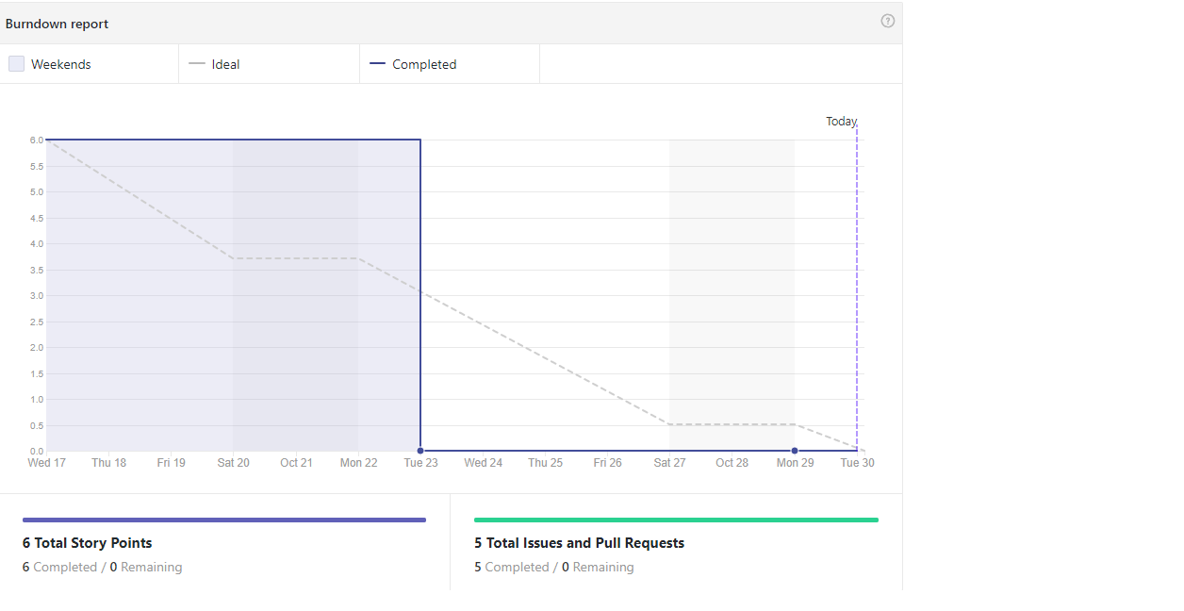
Burndown Chart

Slide 7
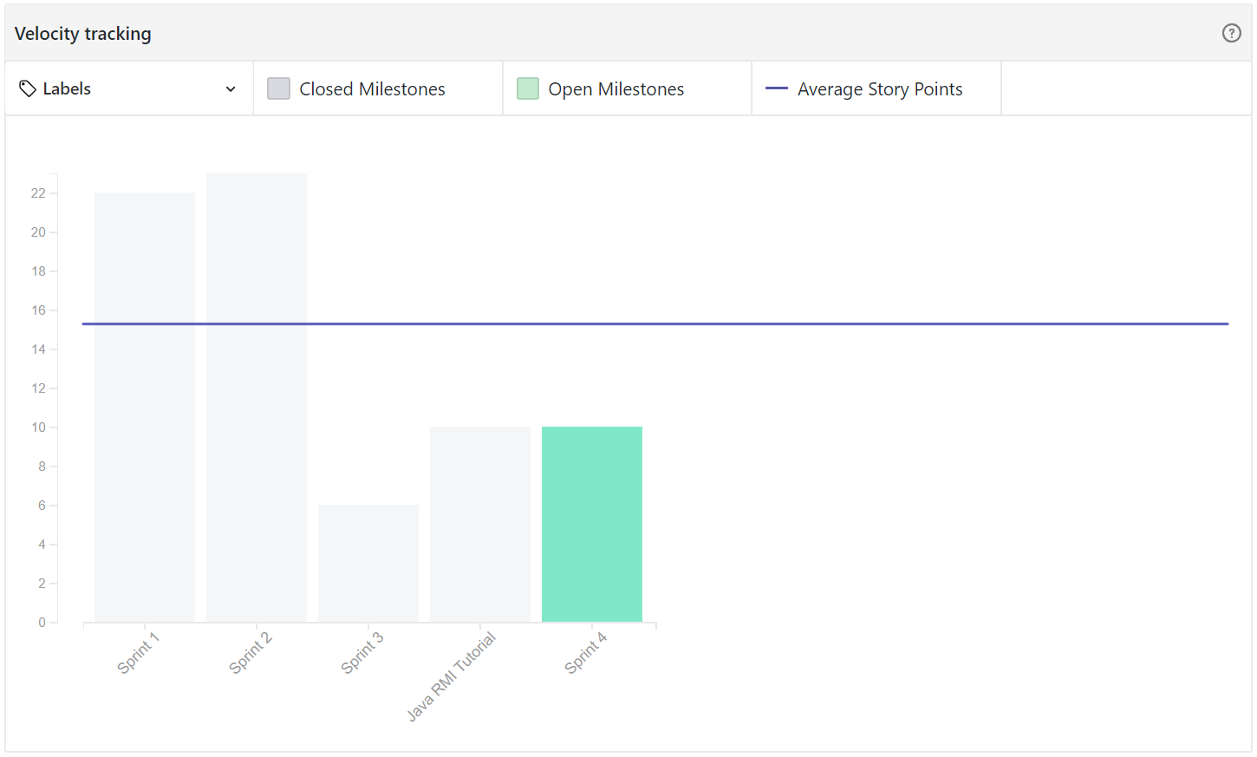
Velocity Chart

Slide 8
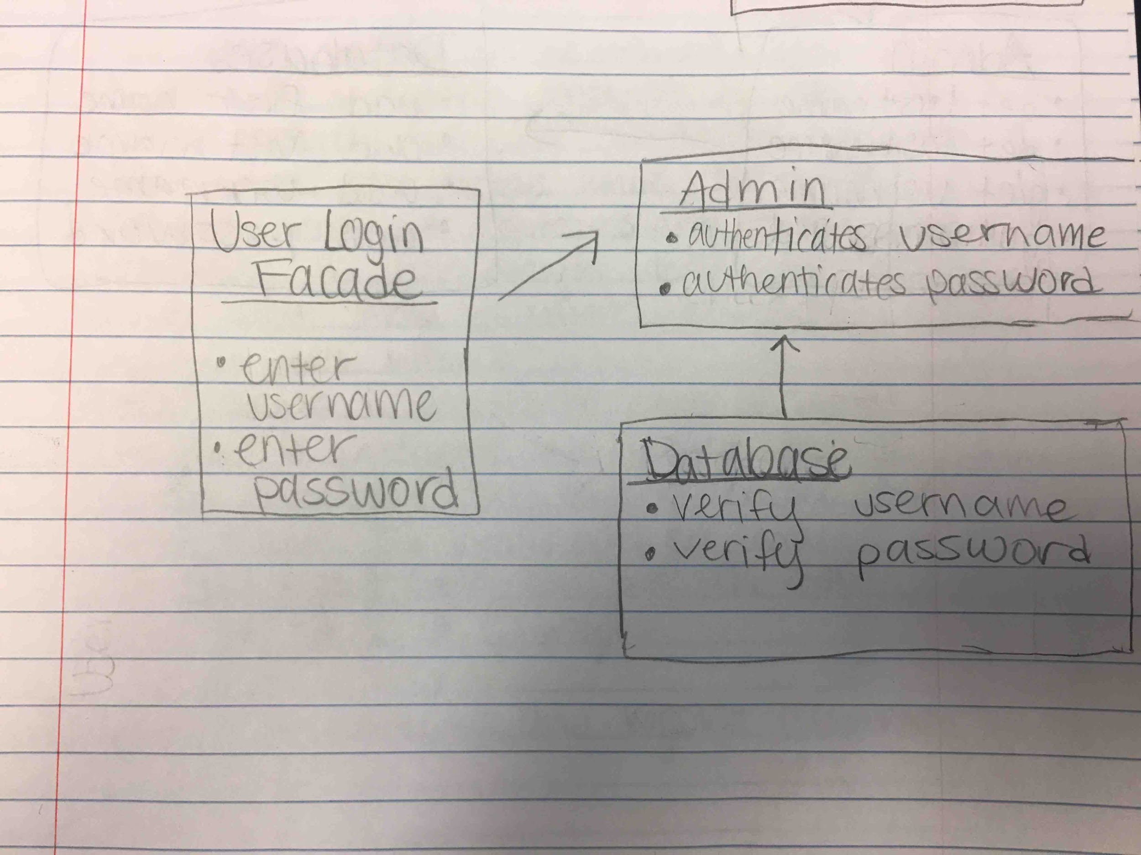
Facade Patterns - Login Page

Slide 9
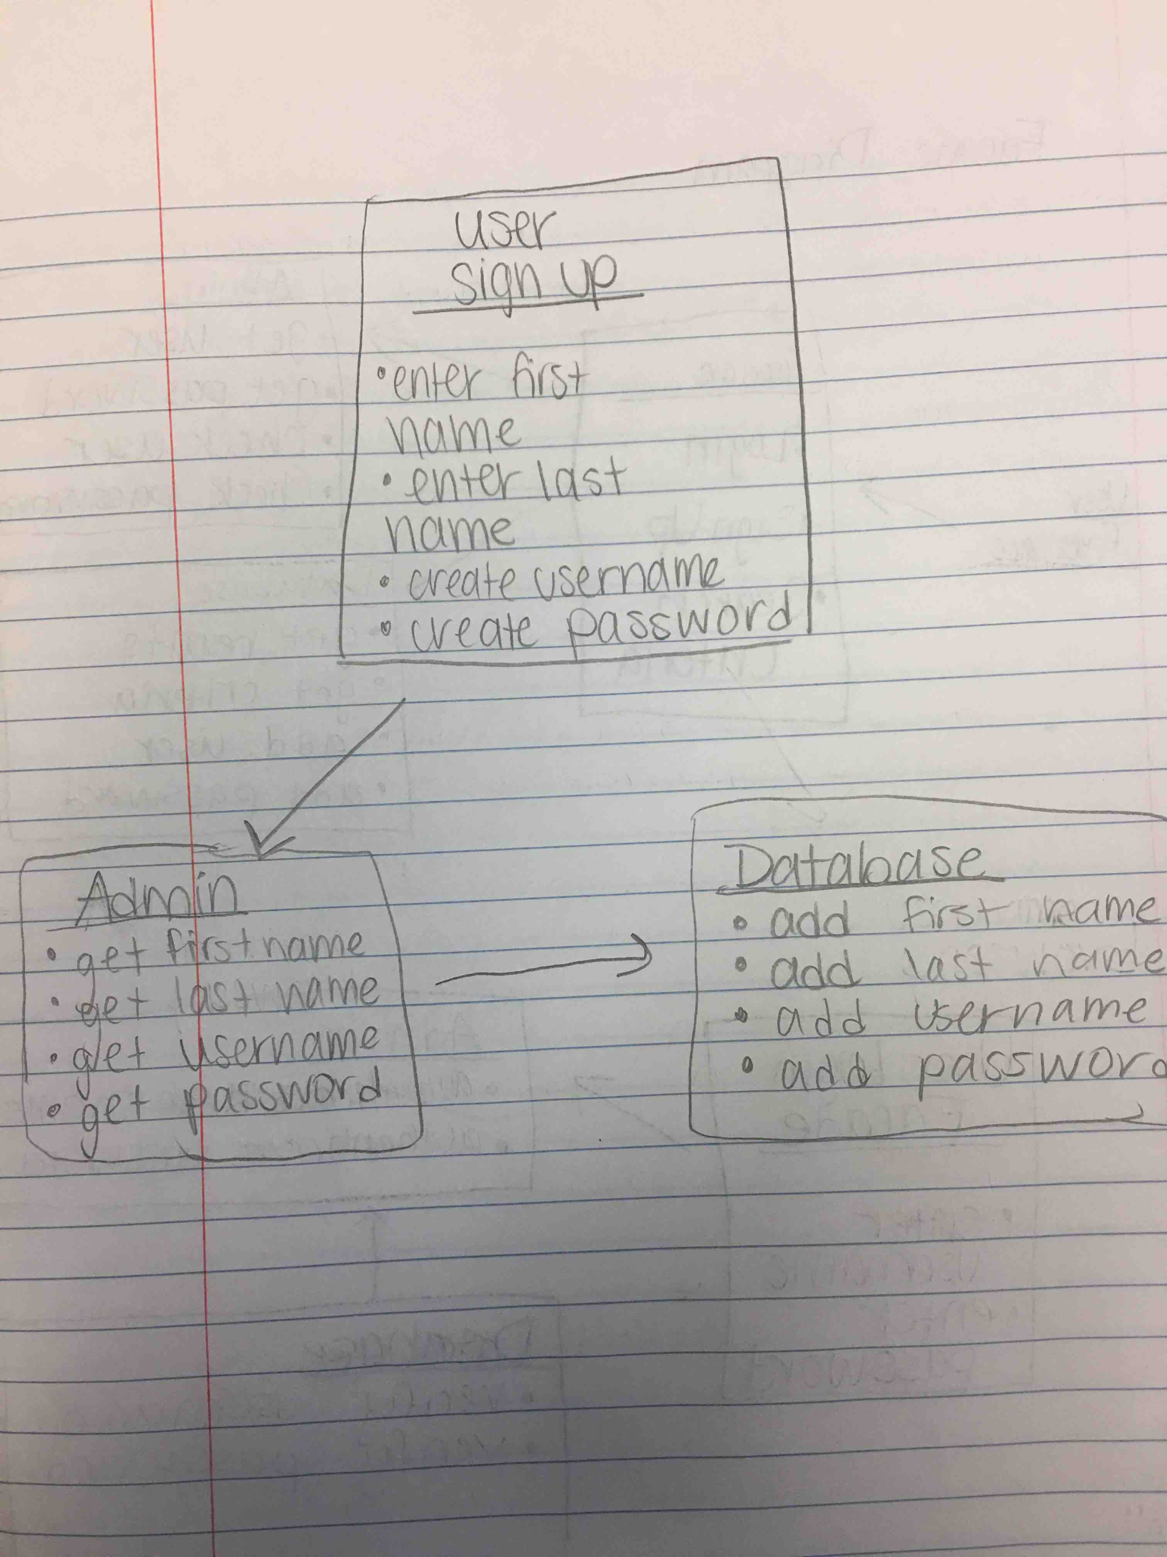
Facade Diagram - Sign Up Page

Slide 10
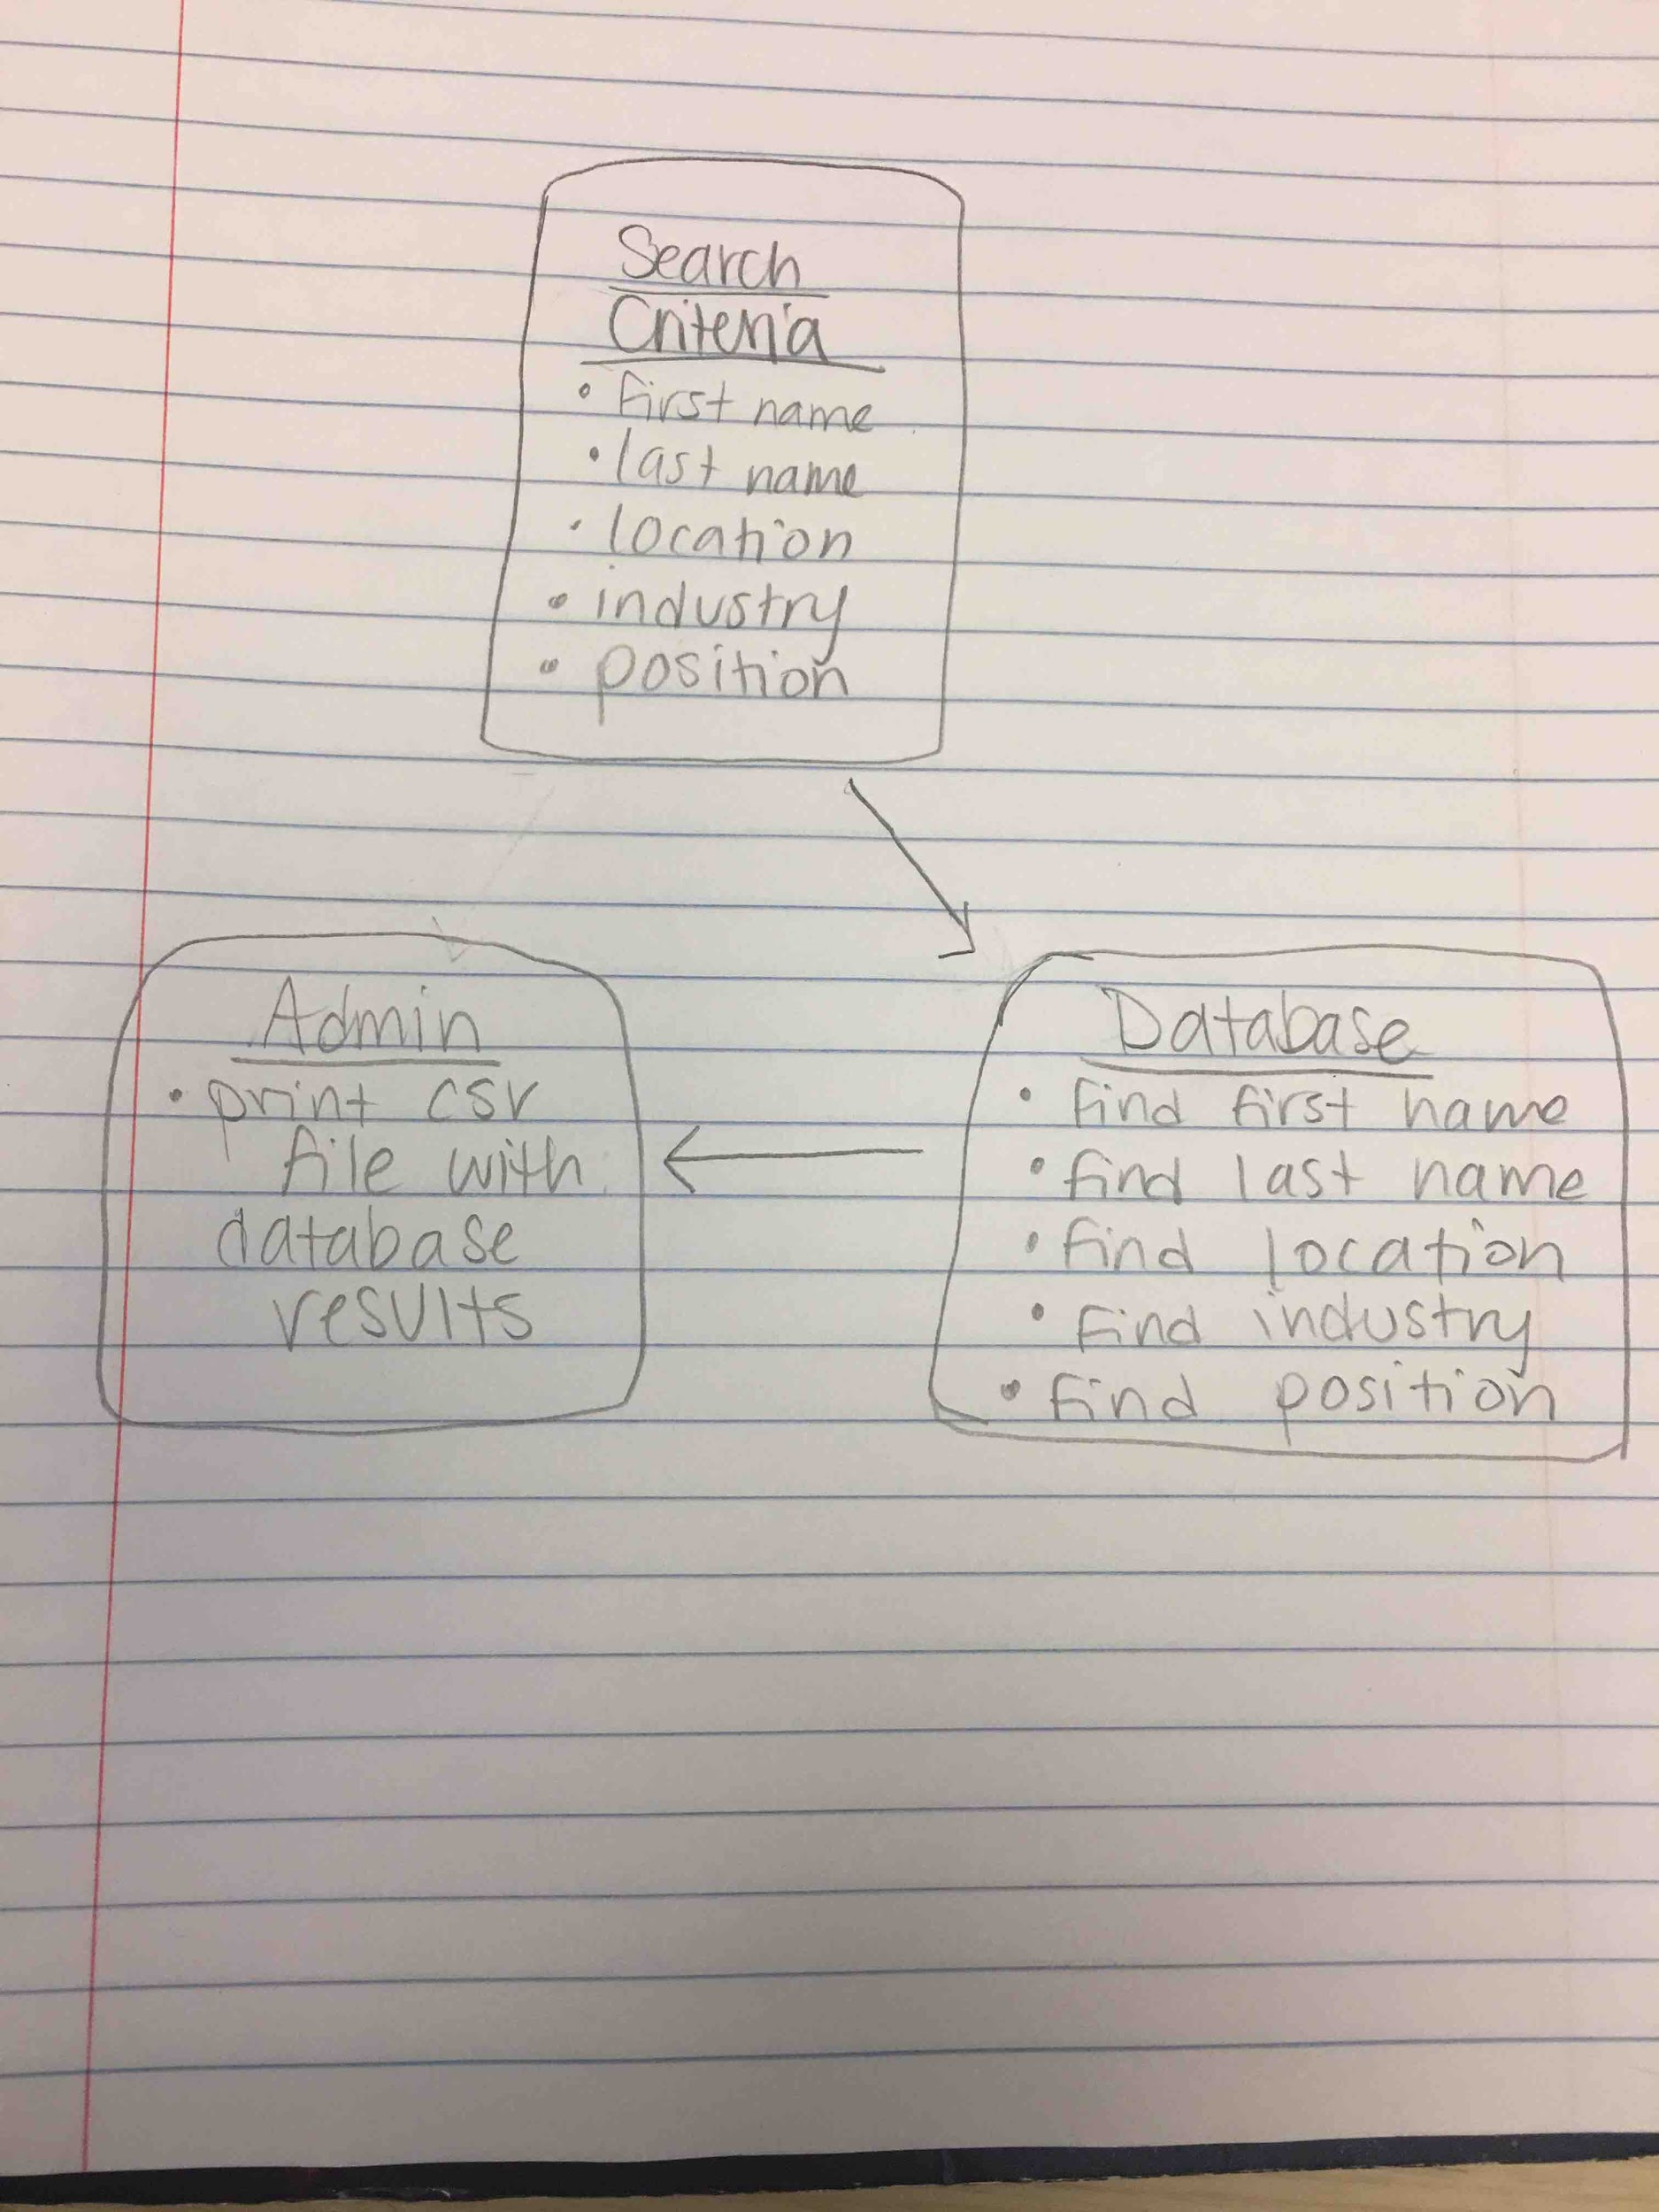
Facade Diagram - Search Page

